Slide 1
PREDICTIVE ANALYTIC PRINCIPLES · ACTL4003 Project
Predicting Mesothelioma Survival
Using Gene Expression
& DNA Methylation
A genomic classification study using TCGA data
Daniel Katz · 21481136 | Nevin Soji · 21488043
RNA-SEQ · DNA METHYLATION
ELASTIC NET · RANDOM FOREST
N = 86 MPM TUMOURS

Slide 2
PROBLEM STATEMENT
THE CHALLENGE
Malignant Pleural Mesothelioma: rare, fatal — and difficult to predict
DISEASE CONTEXT
THE GAP
OUR GOAL
MPM is a rare thoracic cancer primarily caused by asbestos exposure, with highly variable patient outcomes not explained by histology alone.
Conventional clinical groupings only partially explain observed variation. Additional molecular factors likely influence prognosis (Hmeljak et al., 2018).
Use multiomic genomic data — RNA-Seq and DNA methylation — to improve individual-level 500-day survival prediction.
Better prognostic models allow more accurate identification of high-risk patients who benefit from targeted treatment, and low-risk patients who can avoid unnecessary intervention — improving both outcomes and cost-effectiveness.
02 / 16

Slide 3
LITERATURE
WHAT THE RESEARCH SAYS
Prior Work & Methodological Foundations
🔬 MESOTHELIOMA BIOLOGY
📐 STATISTICAL METHODS
Hmeljak et al. (2018) — Identified molecularly defined MPM subgroups independent of histological classification via TCGA integrative profiling.
Penalised Regression — Friedman et al. (2010) — reduces overfitting through shrinkage in high-dimensional settings with correlated predictors.
Mangiante et al. (2023) — Classified MPM via four axes: ploidy, morphology, adaptive immune response, and CpG methylator profile.
Random Forest — Liaw & Wiener (2002) — captures nonlinear effects and interactions without pre-specification; attractive for complex biology.
Di Genova et al. (2023) — Demonstrated multiomic integration better captures tumour heterogeneity than any single data type alone.
Yuan et al. (2023) — Methylation-based cancer prediction supports statistical learning in small-n, high-dimensional genomic settings.
03 / 16

Slide 4
DATA
THE CANCER GENOME ATLAS · TCGA
Dataset Overview
500 days
86
Binary survival threshold
MPM TUMOURS
Response variable defined from survival information as whether a patient lived longer than 500 days.
85
METHYLATION DATA
EXPRESSION DATA
Array-based DNA methylation profiles measuring epigenetic modification at CpG sites, reflecting regulatory state beyond gene sequence.
RNA sequencing measuring gene activity across the transcriptome, capturing active biological processes in each tumour sample.
WITH RNA-SEQ
86
WITH METHYLATION
04 / 16

Slide 5
Methylation
Model Framework
INTERNAL
AUC CRITERION
Multiomics view of the 500-day survival prediction pipeline
tuning parameter used for model selection
Feature Filtering
Variance-based filtering and preprocessing reduce the omics layers to model-ready feature sets
Model Selection
TCGA Source
Elastic net and random forest are compared across expression, methylation, and multiomic inputs
Expression
Methylation
Public mesothelioma cohort with matched clinical, expression, and methylation data
CV Strategy
ML MODEL
Repeated cross-validation provides internal validation and tuning in a small cohort
Cohort size (n=86)
Sensitivity / Specificity
Small-sample setting motivating careful validation and feature filtering
Performance is interpreted through discrimination and clinically meaningful classification trade-offs
Biological Heterogeneity
Variable Importance
Marked intertumoral variation motivates multi-omics modelling rather than reliance on morphology alone.
Multiomic
Top genes and probes help explain which molecular features drive predictive signal
EXTERNAL
500-Day Threshold
Binary classification boundary for survival outcome
05 / 16

Slide 6
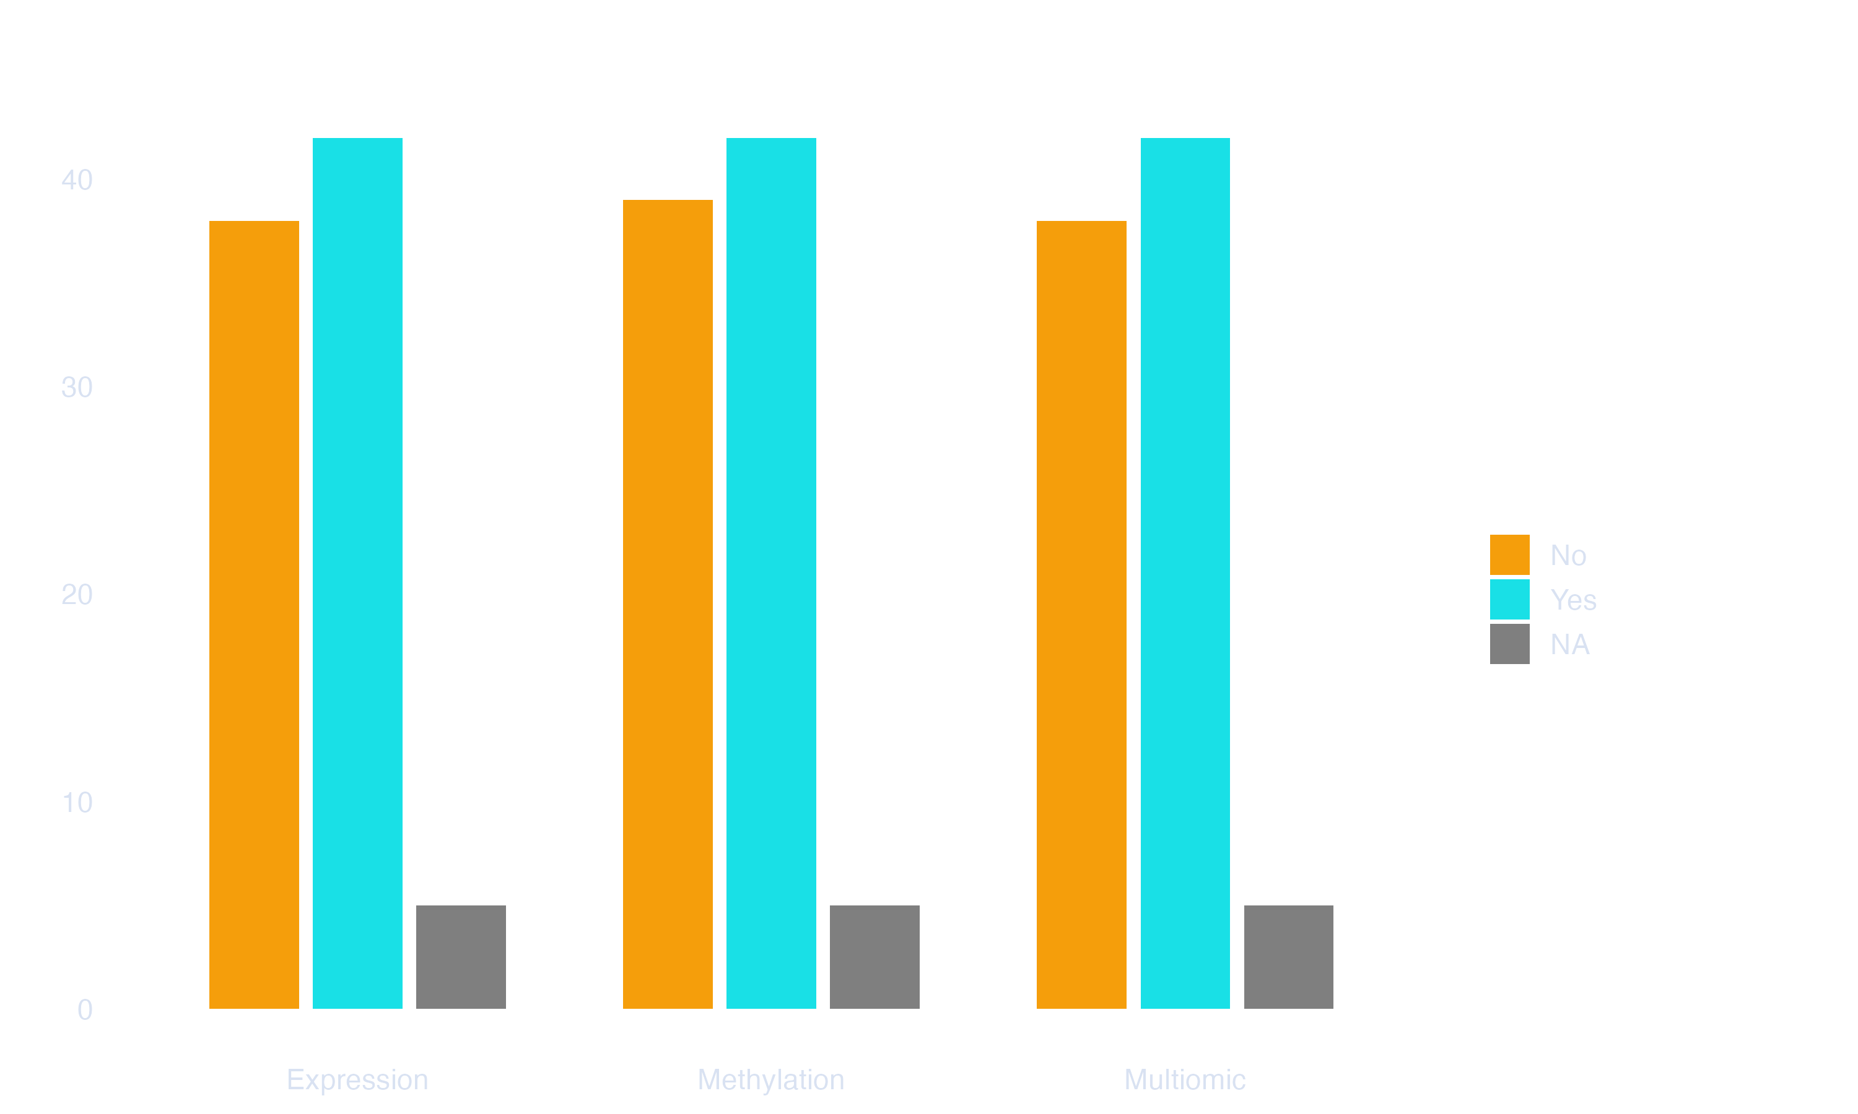
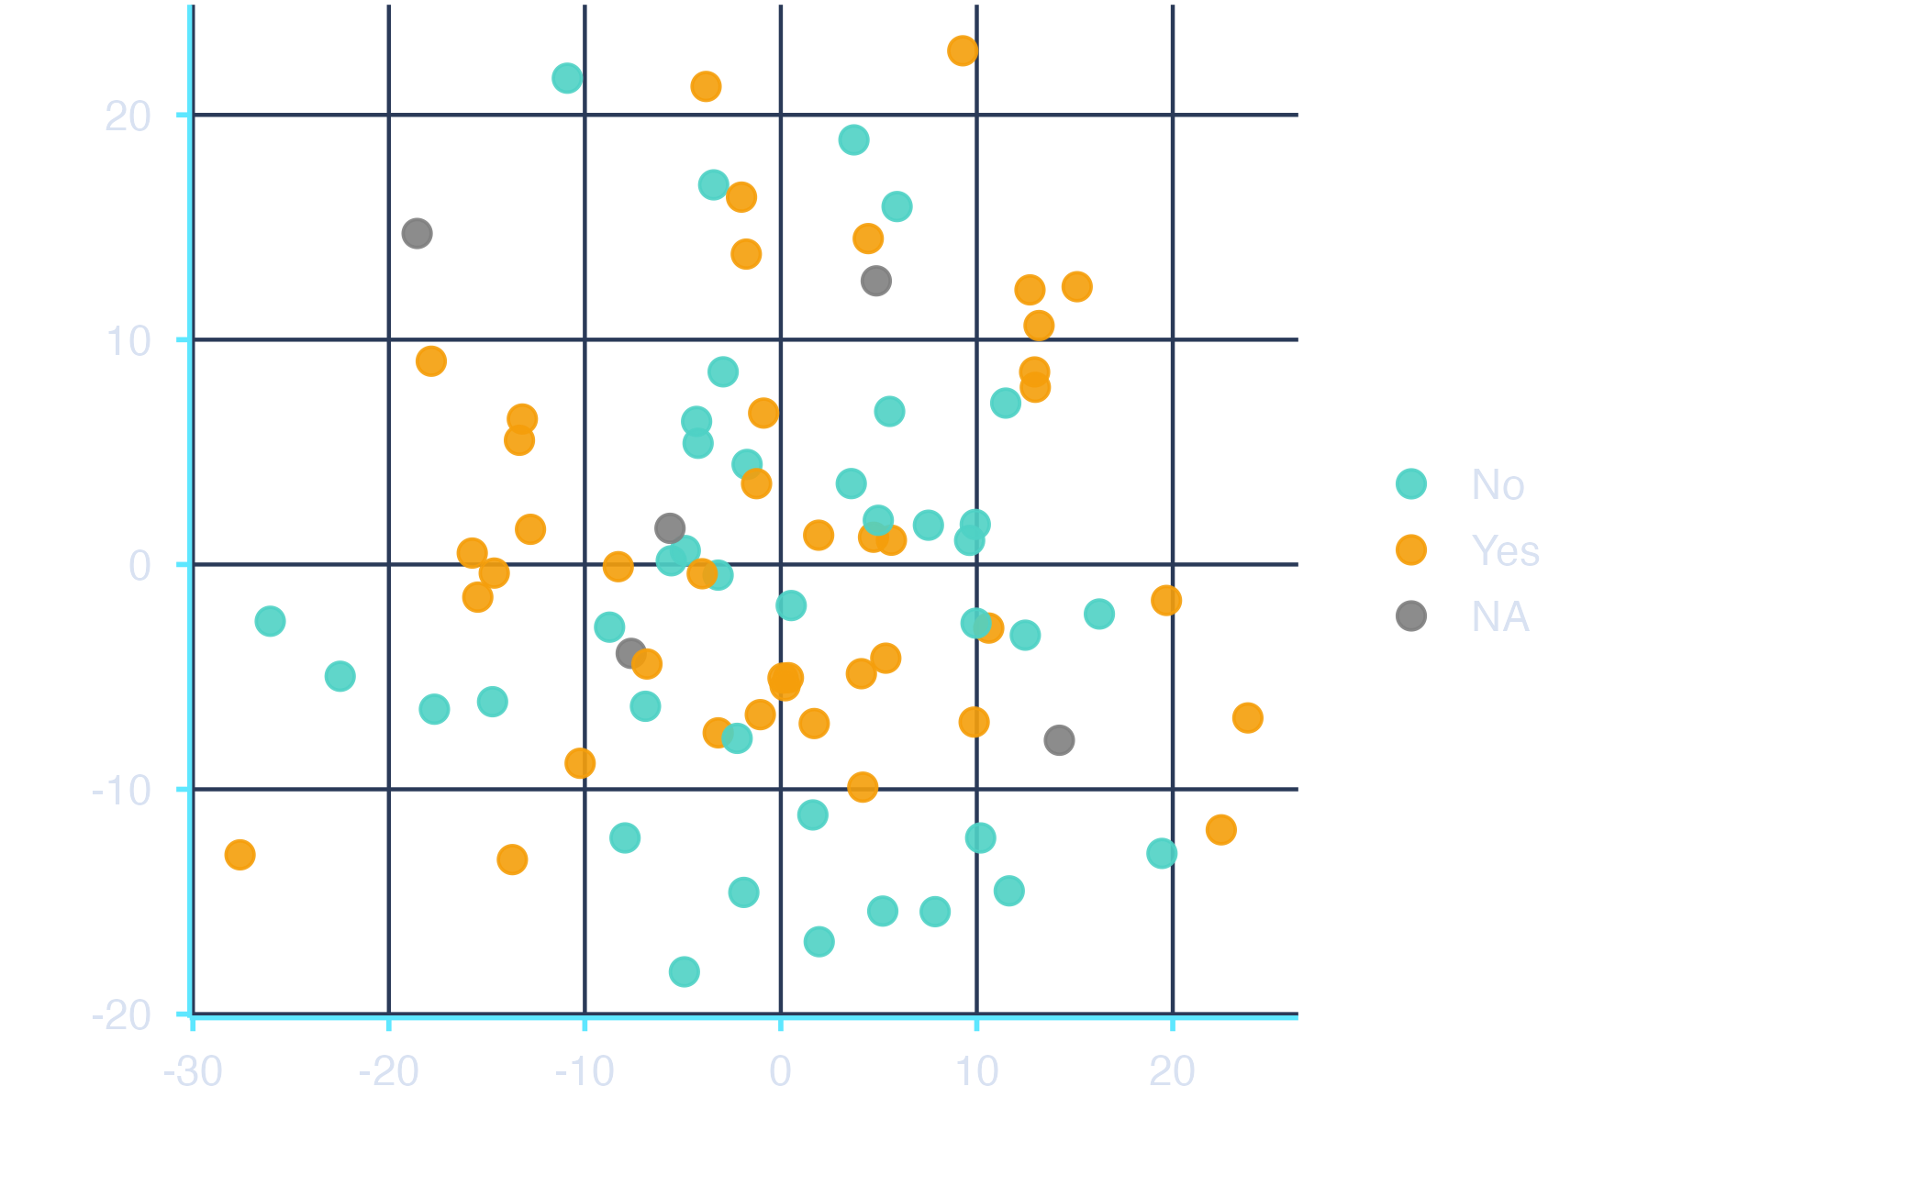
PREPROCESSING
Exploratory Data Analysis
Data Construction
EDA takeaway
Dataset | Cases
Clinical master | 86
Expression matched | 85
Methylation matched | 86
Multiomic matched | 85
Clinical missingness needed to be checked, but modelling focused on omics rather than expanded clinical benchmarking.
PCA on top-variance features suggested substantial heterogeneity rather than clean class separation.
This supported supervised modelling rather than relying on visual clustering.
500-day Survival Class Balance by Cohort
Methylation PCA
Top-variance methylation features coloured by 500-day survival outcome
06 / 16

Slide 7
PREPROCESSING
FEATURE ENGINEERING PIPELINE
Data Construction
Master File n=86
͢
Expression Matched n=85
͢
Methylation matched n=86
͢
Multiomic matched n=85
🧬 RNA EXPRESSION
⚗️ DNA METHYLATION
⚗️ MULTIOMIC
Raw Features: 59,563 genes
Labelled cases: 80
Filtering: complete genes + remove zero variance + top 2,000 by variance
Final Matrix: 80 x 2,000
Raw Features: 486,426 probes
Labelled Cases: 81
Filtering: Remove probes with >10% missingness; undefined variance; median impute; retain top 2,000 by variance.
Final Matrix: 81 x 2,000
Source: combined expression + methylation
Labelled Cases: 80
Construction: top 1,000 expression +top 1,000 methylation
Total Retained Features: 2,000
Final Matrix: 80 x 2,000
͢
͢
+
=
Raw Features
Retained Features
Raw Features
Retained Features
Top Genes (Expression)
Top Genes (Methylation)
Retained Features
FEATURE-SET LOGIC
Compact clinical cohort → matched omics cohorts → variance / missingness filtering → model-ready expression, methylation, and multiomic matrices
07 / 16

Slide 8
METHODS
MODELLING STRATEGY
Two Algorithms · Three Predictor Sets
📉 ELASTIC NET
🌲 RANDOM FOREST
Penalised Logistic Regression
Nonlinear Ensemble Classifier
— Blends L1 (Lasso) and L2 (Ridge) penalties for flexible shrinkage
— Captures nonlinear effects and interactions without pre-specification
— Well-suited for correlated predictors in high-dimensional settings
— Robust to irrelevant features in high-dimensional (p >> n) settings
— Implicitly performs feature selection or diffuse shrinkage
— Produces variable importance scores linking predictions to biology
— Efficient linear benchmark for genomic classification
— Flexible nonlinear comparator for complex genomic applications
VALIDATION STRATEGY
5-fold cross-validation repeated 5 times — selected over a fixed train/test split because the small cohort (<86 patients) would make single-split estimates unstable. Tuning parameters selected by maximising cross-validated AUC (ROC). Class probabilities retained throughout.
08 / 16

Slide 9
RESULTS
CROSS-VALIDATED PERFORMANCE
Model Comparison Across Omics Settings
AUC COMPARISON
SENSITIVITY | SPECIFICITY
0.629 | 0.748
0.644 | 0.720
0.654 | 0.735
0.656 | 0.641
0.630 | 0.696
0.556 | 0.753
Multiomic Random Forest ★
0.756
Methylation Random Forest ★
0.747
Methylation Elastic Net
0.731
Multiomic Elastic Net
0.729
Expression Random Forest
0.722
Expression Elastic Net
0.717
★ Best overall: Multiomic RF achieved the highest AUC = 0.756; methylation RF was the strongest single-omics model with AUC = 0.747.
09 / 16

Slide 10
RESULTS
ROBUSTNESS CHECK
Sensitivity analysis
0
Methylation RF performance remained in the low-to-mid 0.70 AUC range across feature counts and cross-validation designs.
Scenario | AUC | Note
1,500 probes | 0.755 | Highest sensitivity run
2,000 probes | 0.749 | Final tuned methylation RF
2,500 probes | 0.741 | Slightly lower
3×5 CV | 0.734 | Alternative resampling
10×3 CV | 0.728 | Alternative resampling
1
0
A smaller methylation feature set may reduce noise and improve stability.
2
Interpretation
Performance was not driven by one arbitrary feature-count choice, although smaller feature sets sometimes improved stability.
10 / 16

Slide 11
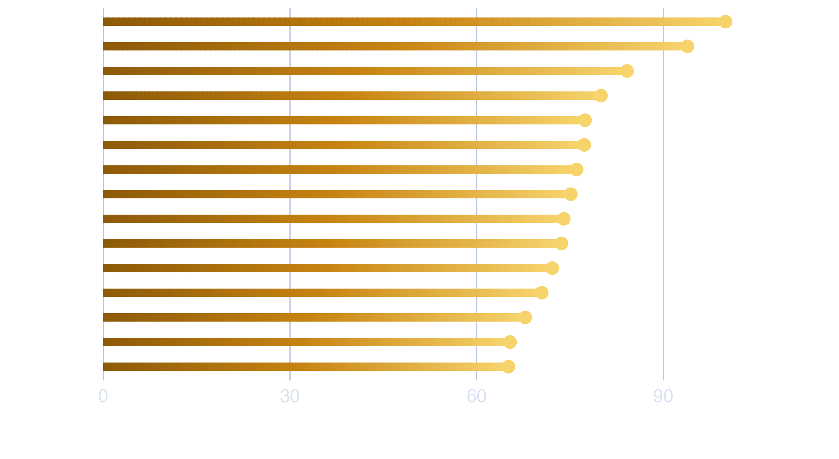
RESULTS
BIOLOGICAL INTERPRETABILITY
Top Methylation Features Mapped
Random Forest Variable Importance
cg12186771
cg04552451
cg19872463
cg09884146
cg01268824
MTMR7
Gene body
LAG3
TSS200 - enhancer
SPRED2
5′ UTR / enhancer
ZNF154
TSS1500
Several high-importance probes mapped to promoter-proximal or gene-associated regions.
Supporting the biological plausibility of the methylation signal.
11 / 16

Slide 12
FINDINGS
WHAT WE FOUND
Three Central Conclusions
0
METHYLATION IS THE STRONGEST SINGLE-OMICS SOURCE
1
DNA methylation provided the strongest standalone prognostic signal. The methylation-only random forest achieved AUC = 0.747, outperforming both expression-based models. This aligns with prior literature identifying CpG methylation as a key axis of MPM tumour heterogeneity.
0
RANDOM FOREST OUTPERFORMS ELASTIC NET
2
Across expression, methylation, and multiomic settings, random forest models generally produced stronger discrimination than elastic net. This suggests that nonlinear relationships and interactions may be important in the molecular survival signal.
0
MULTIOMIC INTEGRATION IMPROVES MODESTLY
3
The best overall model was the multiomic random forest, with AUC = 0.756. However, the improvement over methylation alone was modest, suggesting that methylation captured much of the dominant prognostic signal while combined omics added limited complementary information.
12 / 16

Slide 13
INTERPRETATION
CLINICAL & BIOLOGICAL MEANING
What Do These Results Actually Tell Us?
SENSITIVITY VS. SPECIFICITY TRADE-OFF
ELASTIC NET TUNING PATTERNS
Best models: Sensitivity ~0.63–0.64, Specificity ~0.72–0.75.
Better at correctly identifying longer-surviving patients than poor-outcome patients. A meaningful fraction of high-risk patients would still be missed — models support coarse prognostic stratification, not standalone clinical decisions.
Expression EN → Lasso-leaning: a sparse gene subset drives prediction (sharp but noisy signals).
Methylation EN → Ridge-like: signal spread across many correlated probes, reflecting broader regional methylation structure. Biologically plausible differences in data architecture.
PERFORMANCE CONTEXT
VARIABLE IMPORTANCE
AUC ~0.75 represents moderate discrimination — clearly above chance. Given only ~80 labelled patients in a rare, heterogeneous cancer, this constitutes meaningful predictive signal rather than noise.
Top methylation probes and expression genes are indicators of predictive usefulness, not established causal drivers. They provide a valuable starting point for downstream biological investigation into mesothelioma progression pathways.
13 / 16

Slide 14
LIMITATIONS
HONEST ASSESSMENT
Limitations of This Analysis
SMALL SAMPLE SIZE
BINARY OUTCOME
Only ~80 labelled patients available after matching and outcome construction. In a high-dimensional genomic setting, this limits stability and makes estimates sample-sensitive even under repeated cross-validation.
The 500-day binary threshold compresses a more complex time-to-event process into a simpler classification task, discarding information about the timing and censoring structure of survival data.
CONCATENATION STRATEGY
INTERNAL VALIDATION ONLY
Multiomic integration used direct feature concatenation. The limited gain should not be taken as evidence that more sophisticated integrative approaches (late-fusion, latent factor models) would also fail.
Results rely on repeated internal cross-validation. External validation on an independent mesothelioma cohort is necessary for a stronger assessment of generalisability.
14 / 16

Slide 15
FUTURE WORK
NEXT STEPS
Directions for Future Research
PRIORITY 01
PRIORITY 02
External Validation
Advanced Integration
→
Independent mesothelioma cohort to assess true generalisability beyond internal cross-validation.
Late-fusion or latent-factor methods to better recover complementary information across omic layers.
PRIORITY 03
PRIORITY 04
Survival Modelling
Biological Follow-up
→
Move from binary classification to full time-to-event analysis using censored survival models.
Investigate high-importance methylation probes for mechanistic links to MPM progression pathways.
15 / 16

Slide 16
SUMMARY
CONCLUSION
Genomic data can predict mesothelioma survival —
methylation leads the way
FINDING 01
FINDING 02
FINDING 03
Multiomic RF Performs Best
Methylation Leads Single-Omics
Random Forest Wins
Best overall model: AUC = 0.756. Combining expression and methylation produced the strongest discrimination, although the improvement over methylation alone was modest.
Methylation RF achieved AUC = 0.747, outperforming expression-based models. Epigenetic variation appears to carry substantial prognostic signal.
Random Forest outperformed Elastic Net across the main omics settings, suggesting nonlinear flexibility helped capture molecular structure.
These findings show that omics-based survival prediction is feasible in mesothelioma, but the small cohort and high-dimensional feature space mean results should be treated as promising internal evidence rather than clinically validated prediction.
DANIEL KATZ · 21481136
NEVIN SOJI · 21488043
2026
16 / 16

